Slide 1
The national bioinformatics infrastructure www.scilifelab.se/platforms/bioinformatics/
Anna Johansson, anna.johansson@scilifelab.se
Bioinformatics Long-term Support (a.k.a.WABI)

Slide 2
The Bioinformatics platform
SciLifeLab
National Genomics Infrastructure
Bioinformatics
Clinical Diagnostics
…
Joakim Lundeberg Ann-Christine Syvänen
Ulf Gyllensten
Bengt Persson
Ongoing merge of BILS, WABI and more; complete 2016.
National, distributed

Slide 3
BIOINFORMATICS
NGI
Genomics development
Lab Bioinfo
Project support and tools development
Sequencing
Supercomputer center
Genomics
accounts
Customer project accounts
GENOMICS DELIVERY
PREDEFINED ANALYSES
CUSTOM-TAILORED ANALYSES

Slide 4
The bioinformatics platform
20 projects/year
Long-term
500 h / project
400 projects/year
Short-term
80 h / project
System design/ development/allocation
400 projects/year (only NGS)
Compute
Number of projects
Support hours per project

Slide 5

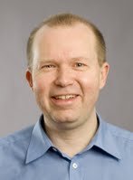
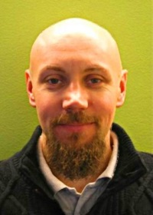
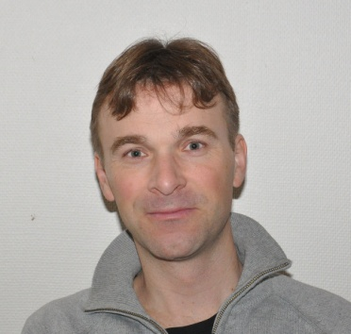
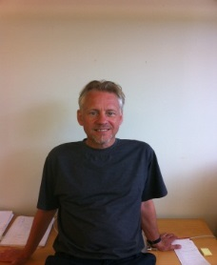
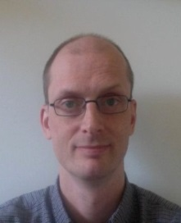


Short-term Support and Infrastructure BILS – Bioinformatics Infrastructure for Life Sciences
www.scilifelab.se/facilities/bils/
Technical Proteomics Director coordinator coordinator
BILS is a distributed national research infrastructure supported by the Swedish Research Council (VR)
Nodes at each of the 6 large univerisities
Coordination with other bioinformatics activities
Training activities, annual symposium/user meeting
BILS provides
Support/Consultancy (“human eCloud” for life sciences) 80 hours for free, additional hours for a subsidised fee
Databases and software tools Computing and storage in collaboration with SNIC
BILS coordinates the Swedish node in the European infrastructure for biological information ELIXIR
Annual budget ~3.5 MEUR (2014)
~2.2 MEUR from Swedish Research Council
~1.3 MEUR from SciLifeLab and participating universities
Bengt Mikael Fredrik Persson Borg Levander
Syst. development Training
Genomics coordinators coordinator coordinator
Magnus Henrik Jonas Sara
Alm-Rosenblad Lantz Hagberg Light

Slide 6

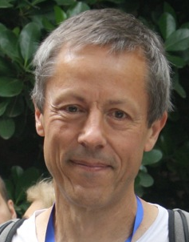
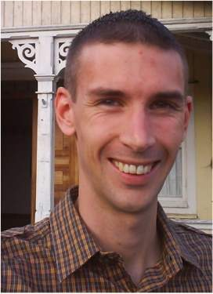


Long-term Support
Wallenberg Advanced Bioinformatics Infrastructure
www.scilifelab.se/facilities/wabi/
Tailored solutions – high impact
Applied bioinformatics: 500h free support/project
Variant analyses in health and disease
Transcriptomics
Novel genomes
Metagenomics
Directors
Swedens strongest unit for analyses of large-scale genomic data (13 + 10 FTE)
Siv Andersson
Gunnar von Heijne
Managers
National committee reviews and selects projects based on scientific quality
Ongoing expansion with staff in Lund, Gothenburg, Linköping and Umeå.
Björn Nystedt
Thomas Svensson

Slide 7
Expert teams
Assembly/annotation of novel genomes
support@bils.se
(2 + 2 people, running)
Human WGS ToolBox
Method implementation, community building
https://wabi-wiki.scilifelab.se/display/SHGATG/
(2+ people, running)
BigData/Integrative bioinformatics
Method development, project support
http://www.scilifelab.se/facilities/wabi/
(4 people, hiring now, part of Long-term Support)

Slide 8
Growth (Numbers from BILS)
Study design + bioinformatics typically the bottleneck in projects

Slide 9
Distribution of PIs in projects in 2013
~400 short-term projects/year
~20 long-term projects/year

Slide 10


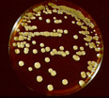

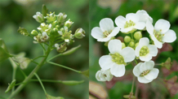
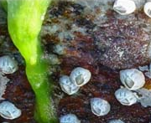
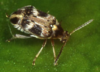


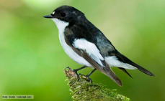
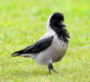
Huge project diversity => difficult to forsee/automate
7 Variant analyses in medical research Human
4 Differential gene expression
3 single-cell RNAseq
2 Epigenetics
1 miRNA
1 Allele-specific expresssion + methylSeq
1 Immunorepertoire
1 Integrative
20
5 Variant calling/Population genomics Animals/plants
4 De novo genome assembly/analyses Animals/plants
3 Gene expression Animals/Plants
2 RNAseq method development Universal
1 RNAseq + proteomics Fungus
1 Metagenomics Human microbiota
1 Non-coding RNA Bacteria
17

Slide 11
User evaluation
Bioinformatics Long-term Support: User evaluation April 2015

Slide 12
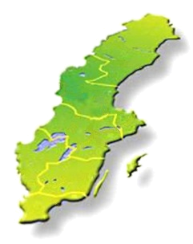
Bioinformatics Platform provides custom-tailored analyses
Compute and storage (free; majority of hardware and system administration belongs to SNIC) http://www.uppmax.uu.se/
Study design consultation (free) support@bils.se
Short-term support (≤80h; free; first come first serve)
Medium-term support (>80h; user fee; first come first serve) http://bils.se/resources/supportform/index.php
Long-term support (500h; free: scientific evaluation) http://www.scilifelab.se/facilities/wabi/
Next deadline for applications June 12!

Slide 13
SciLifeLab Bioinformatics Courses
Course | Date | Participants | Evaluation score (max 5)
Introduction to bioinformatics using NGS data | April 2013 | 24 | 4.6
 | Nov 2013 | 24 | 4.3
 | March 2014 | 24 | 4.5
 | April 2014 | 24 | 3.8
 | Sept 2014 | 24 | 4.1
 | Nov 2014 | 24 | 4.3
Perl programming for biological sciences | May 2013 | 20 | 4.4
 | Oct 2013 | 20 | 4.4
 | May 2014 | 20 | 4.7
 | Oct 2014 | 20 | 4.5
Genome Assembly | Nov 2013 | 20 | 4.1
 | Nov 2014 | 20 | 4.4
Human Genetic Variation | June 2013 | 15 | 4.5
 | Sept 2013 | 20 | 3.9
RNAseq | June 2013 | 15 | 4.1
 | Sept 2013 | 20 | 4.2
 | Oct 2014 | 20 | 4.3
RNAseq and proteomics | June 2014 | 20 | 4.1
Metagenomics | Nov 2014 | 20 | 4.2
TOTAL 2013 + 2014 |  | 394 | 4.3

Slide 14
Teaching
www.scilifelab.se/education/courses/
Ex spring 2015
2015-02-09 - 2015-02-13, Course | Uppsala
Introduction to Bioinformatics using NGS data, 2 hp
2015-04-07 - 2015-04-09, Course | Uppsala
RNA-seq, 1 hp
2015-04-27 - 2015-04-28, Course | Uppsala
Introduction to Genome Annotation, 1 hp
2015-05-18 - 2015-05-22, Course | Gothenburg
Introduction to Bioinformatics using NGS data, 2 hp
2015-05-18 - 2015-05-23, Course | Uppsala
Perl Programming with Application to Bioinformatics, 2 hp

Slide 15
The Swedish Bioinformatics Advisory Program
A new teaching model, where PhD students get a senior bioinformatician as a personal advisor during 2 years of their PhD.
Three grand meetings per year with all the students, and their advisors and PhD supervisors, to aid networking and knowledge transfer.
First call late 2014:
>50 applicants for 15 places
Next call late 2015
www.scilifelab.se/education/mentorship/the-swedish-bioinformatics-advisory-program/

Slide 16
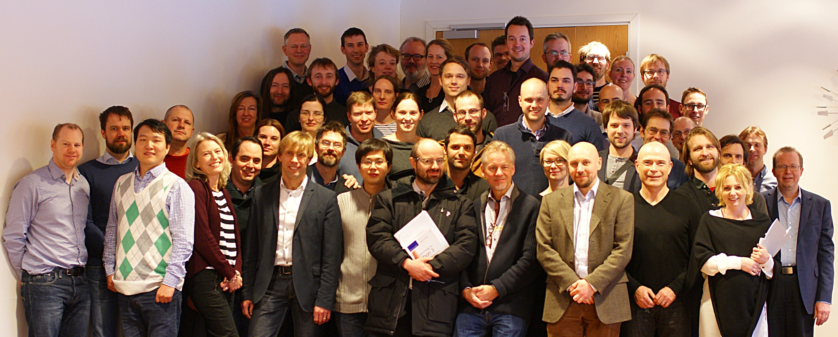
We’re here for you!

